Slide 1
Predicting Car Accidents Severity
Applied Data Science Project

Slide 2
Predicting Car Accidents Severity is valuable & Life Saving Predictor
This project will help to predict the severity of accidents due to changing environmental conditions and vehicle conditions.
Reducing traffic accidents is an important public safety challenge around the world.
Accident prediction is important for optimizing public transportation, enabling safer routes, and cost-effectively improving the transportation infrastructure, all in order to make the roads safer. It will help people making smart and efficient decision on selecting safe road routes to avoid accidents and be cautious.
The purpose of this Capstone Project is to help people to get awareness of accidents occurrences and causes of severe car accidents.

Slide 3
Data acquisition and cleaning
Data Collisions from Applied Data Science course is gathered from 2004 till present.
Metadata explaining each attribute is also collected from Applied Data Science Course.
In total, 1,94,673 rows and 38 features in the raw dataset.
Duplicate, highly similar or highly correlated features were dropped.
Seven features are chosen to predict the model

Slide 4
Dependent & Independent Attributes
Independent =["SPEEDING", "ADDRTYPE","WEATHER" ,"LIGHTCOND" ,"ROADCOND" ,"UNDERINFL" ,"STATUS"]
Dependent=[“SEVERITYCODE”]

Slide 5
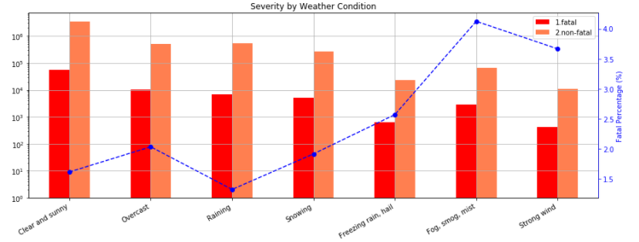
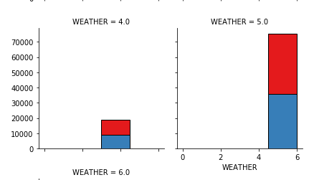
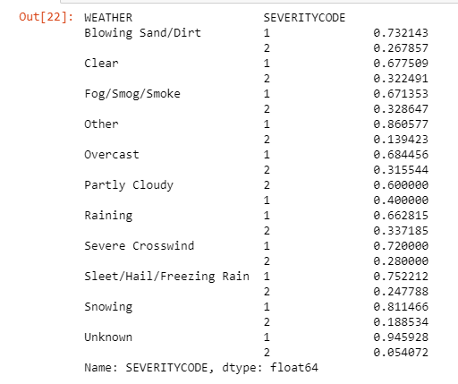
Data Visualization For Weather Conditions

Slide 6
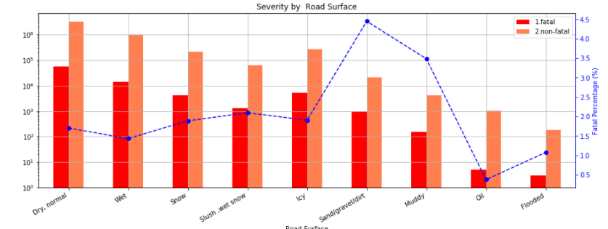
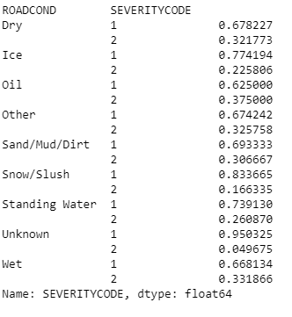
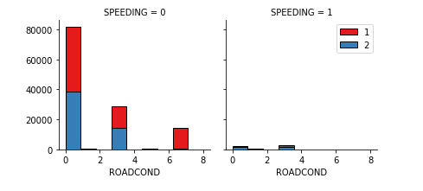
Data Visualization For Road Conditions
Speeding lead to fatal and non fatal accidents

Slide 7
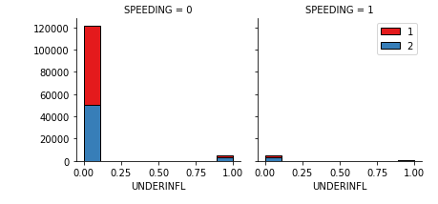
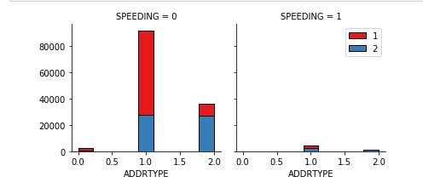
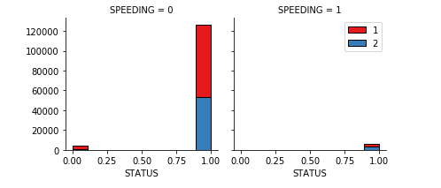
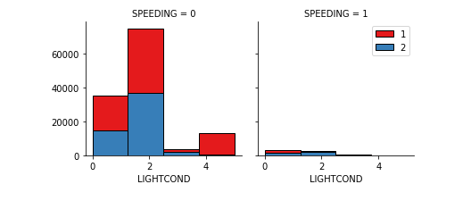
Grouping independent attributes to understand impact through vizualization

Slide 8
Regression model performance
Attributes Contribution
Model Evaluation and Refinement
SPEEDING :0.01516194
ADDRTYPE:0.04063198
WEATHER: 0.01683888
LIGHTCOND: 0.00290239
ROADCOND: 0.01409283
UNDERINFL: 0.01969284
STATUS: 0.09589847
R^2 = 0.590436694340428
Test samples: 29201
Training samples: 165472
Ridge regression: 0.562143
second order polynomial:0.620513

Slide 9
Conclusion
● Built useful models to predict fatal or non fatal car accidents using Data Science.
● Accuracy of the models has room for improvement.
● Capture accidents individual traits, to expand predictions efficiency.

